Slide 1
The 5 components of Information Literacy

Slide 2
What is information literacy?
“…the ability to locate, evaluate, and use effectively the needed information”
YOUR ability to find relevant, credible information regarding a topic.
EG. Your research project on phones that was just completed.

Slide 3
5 Components of Information Literacy Component 1: IDENTIFY
The information literate student can IDENTIFY the nature (type) and extent of information needed.
ACADEMIC EXAMPLES:
- Writing a thesis statement
- Creating a timeline and plan to complete a research paper
- Reading background information on a topic before researching
- Recognizing the difference between a library database and a website
- Differentiating between PRIMARY, SECONDARY and TERTIARY sources of information.

Slide 4
5 Components of Information Literacy Component 1: IDENTIFY
Research and write down the definition and difference between primary, secondary and tertiary sources of information.

Slide 5
5 Components of Information Literacy Component 1: IDENTIFY
Primary Source:
It is a first-hand account of an event, topic or historical event. Anything that contains the original information.
EG: Some examples of original, first-hand, authoritative accounts include: Letters, diaries, journals, autobiographies or memoirs (Personal thoughts), Original photographs, First-hand, eye-witness news reports, Speeches, interviews, First-hand research studies and surveys, Laws, legal documents, etc.

Slide 6
5 Components of Information Literacy Component 1: IDENTIFY
Secondary Source:
A second-hand account that interprets, analyzes, critiques and comes to a conclusion from evaluating primary sources.
EG: Some examples of works that interpret or critique primary sources include: Scholarly research journals written by an expert, Some news articles, Most textbooks, Essays or reviews, Criticisms or commentaries.
HINT: A secondary source will cite the primary sources (the original work) from which they got it.

Slide 7
5 Components of Information Literacy Component 1: IDENTIFY
Tertiary Source:
Information that is compiled from multiple other sources. Its intended purpose is to re-package existing information to provide an overview on a topic.
Of the 3 resources, which two would be best when writing a thesis statement or research paper?

Slide 8
5 Components of Information Literacy Component 2: FIND
The information literate student can FIND needed information effectively and efficiently.
ACADEMIC EXAMPLES:
- Finding an article from the library databases
- Locating a book on the library shelves by its call number
- Choosing keywords and phrases to use in a library catalog search (or when searching google etc)
- Using Boolean terms (AND, OR, NOT) when searching online

Slide 9
5 Components of Information Literacy Component 2: FIND
Find a primary and secondary resource (website) which discusses and describes the National Physical Activity and Sedentary Behaviour guidelines.

Slide 10
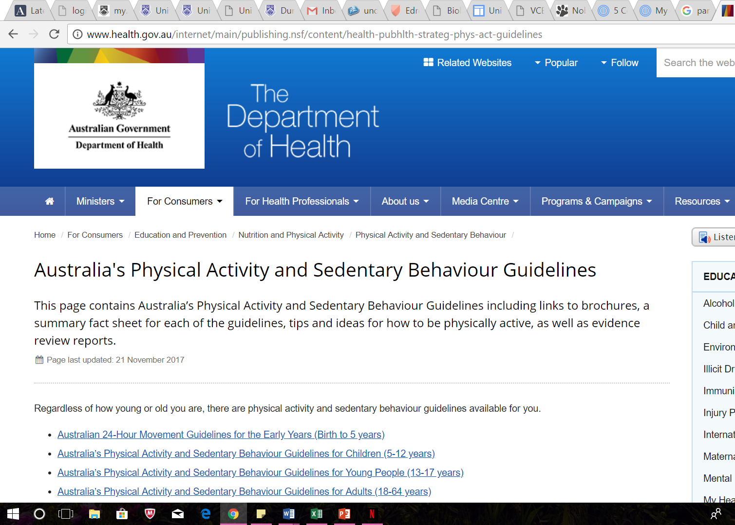
5 Components of Information Literacy Component 2: FIND
A PRIMARY source of information- the Vic Health website.
They developed and created the NPA + SD Guidelines

Slide 11
5 Components of Information Literacy Component 2: FIND
A SECONDARY source of information- this article on the NPA + SD written and published by ABC News
REFERENCED the original source at the end of the article

Slide 12
5 Components of Information Literacy Component 3: EVALUATE
The information literate student can EVALUATE information and its sources critically.
ACADEMIC EXAMPLES:
- Summarizing the main ideas of an article or book
- Reviewing multiple points of view to construct an opinion
- Exploring different sources of information (web, books, databases, primary sources) to understand a topic
- Analysing the structure and logic of arguments made in lectures and speeches
EG. Researching claims made in a add on television, scrutinizing a Wikipedia article for accuracy etc.

Slide 13
5 Components of Information Literacy Component 3: EVALUATE
Take a couple of minutes to find the NPA guidelines for your age group.
READ and UNDERSTAND the guidelines

Slide 14
5 Components of Information Literacy Component 4: APPLY
The information literate student can APPLY information effectively to accomplish a specific purpose
ACADEMIC EXAMPLES:
- Paraphrasing an expert essay to support a position in a persuasive speech
- Integrating a direct quotation from a reference book into a research paper
- Using images from a database to prepare a group PowerPoint presentation

Slide 15
5 Components of Information Literacy Component 4: APPLY
Using Word, create a poster on the National Physical Activity guidelines for your age group (13-17 years).
PARAPHRASE the guidelines for your age group.
- Express the meaning of (something written or spoken) using different words, especially to achieve greater clarity. "you can either quote or paraphrase literary texts"
Include a direct QUOTE from the guidelines on your poster.
Source an IMAGE to add to your poster

Slide 16
5 Components of Information Literacy Component 5: ACKNOWLEDGE
The information literate student can ACKNOWLEDGE sources of information and the ethical, legal, and socio-economic issues surrounding information.
ACADEMIC EXAMPLES:
- Citing an information source in the text of a research paper
- Creating a works cited page of bibliography
- Understanding what constitutes plagiarism
- Utilising Fair Use and Copyright guidelines

Slide 17
5 Components of Information Literacy Component 5: ACKNOWLEDGE
Create a REFERENCE list for your work at the bottom of your poster.
Reference the resources used to gather the information for your poster.

